Slide 1
University
University of Applied Sciences
MBO
Lower vocational education
VWO
Pre-university education
6 years
HAVO
Pre- applied sciences
5 years
VMBO
Pre lower vocational education
4 years
Pracital Education
Primary education (age 4 - 12)

Slide 2
Preparing teachers for the challenges of urban classrooms
2010
50
4
20

Slide 3
Quotes Diaries Student-Teachers
“After watching the news, [about the shooting of a black man by a police officer in the US] children [9-10 years] with a darker skin colour shared their experiences with discrimination.”
“The first thing some girls [11-12 years] said to me [student-teacher]: All white people discriminate, [and a few seconds later] except you miss.”
“…so M [a black child - 8 years] reacts very angry towards me and says: This is discrimination, you put the blame on me because I am black!”

Slide 4
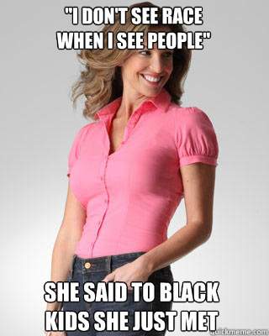

Slide 5
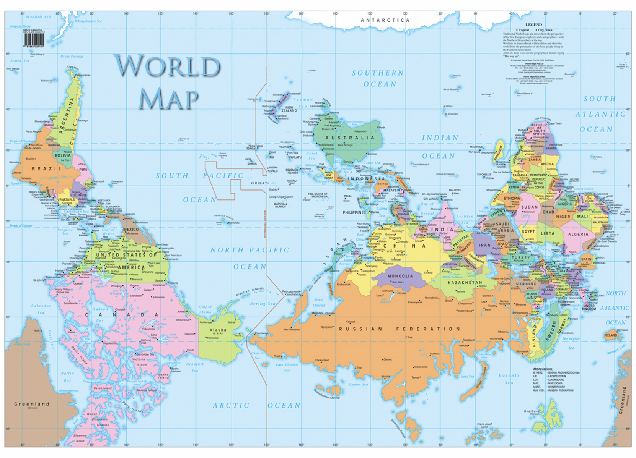

Slide 6
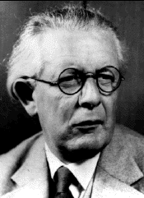
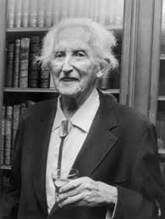
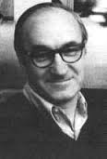
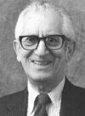
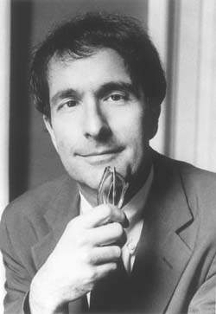
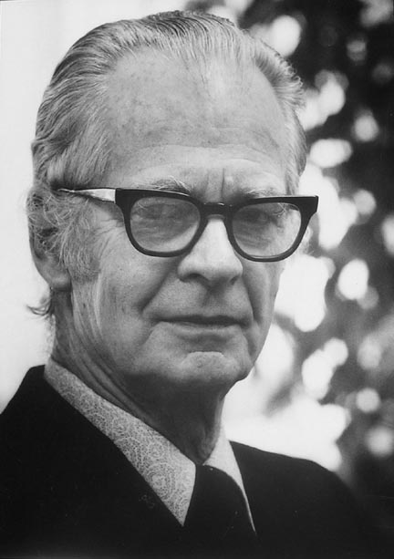
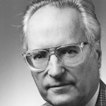
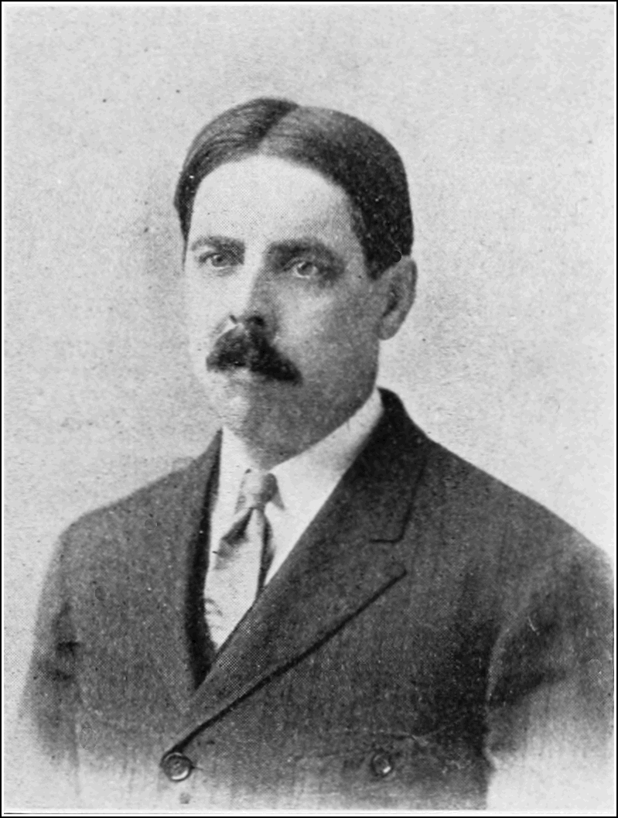

Slide 7
Quote Diary Student-teacher
“ [about classes at the university]…offcourse I learned different things which were helpful, however this is the first time in four years, that I learned stuff, which personally touched me and therefore changed me. And that is confusing: Learning is becoming...”
Notes:
Bij veel vakken weet je natuurlijk dat je wel dingen leert en dat je wijzer wordt, maar ik heb eigenlijk voor het eerst in die vier jaar tijd dat ik iets leer wat mij persoonlijk raakt en verandert . En dat is verwarrend. ‘Learning is becoming...’

Slide 8
Recommendations
Teach student-teachers about Whiteness and the implications regarding their relationships with pupils.
Teach student-teachers about Eurocentric knowledge construction and the impact on their teaching.

Slide 10
Universitaire Pabo van Amsterdam (upva@uva.nl)
Fadie Hanna (f.hanna@uva.nl)

Slide 11
Further reading

Slide 12
White privilege (Tim Wise)
As for the concept white privilege: I am not claiming, nor do I believe, that all whites are wealthy and powerful. We live not only in a racialized sociecty, but also in a class system, a patriarchal system, and one of straight supremacy, able-bodied supremacy, and Christian hegemony. These other forms of privilege, and the oppression experienced by those who can’t access them, mediate but never fully eradicate something like white privilege. So realize that wealthy whites are more powerful than poor ones, white man are more powerful than white woman, able-bodies white more powerful than those with disabilities, and straight and cisgenderd whites more powerful than gay, lesbian, bisexual, or transgendered whites. But despite the fact that white privilege plays out differently for different people, depending on these others identities, the fact remains, that whiteness matters and carries great advantage.

Slide 13
Color blindness (Weiner)
“Color-blind world view, white teachers reify stereotypes, perpetuate white values perceived superiority, privilege white social and cultural capital, ignore their own whiteness and possible role in maintianing social inequality combined with racist imagery and lingustic conceptions of non-Europeans, national discourses posit whiteness ass essential to Dutch identity.”

Slide 14
Whiteness
“Whiteness is a location of structural advantage, a standpoint from which to see oneself and others, and a product of history, compromising a range of cultural practices and identities intersecting with gendered and classed identities.”

Slide 15
Whiteness
“Existing globally and reinvented locally, whiteness ideologies manifest in popular and politcal discourse and images as racial master narratives, which shape institutional policies and daily life experiences and inhibit racialized subjects ability to challenge the system.”

Slide 16
Whiteness
“Contemporay discourses and ideologies of whiteness, rooted in the colonial encounter, use cultural racism frames to posit white people as civilized, clean, orderly, rational, punctual, intellectual and organized, while blackness appears as dirty, chaotic, tribal, irrational, emotional, sexual, exotic, laxy, athletic or criminal.”

